Slide 1

EARTHQUAKE PREDICTION MODEL USING PYTHON
TEAM MEMBER
510521106019: SHARMILA.A
PHASE 5 SUBMISSION DOCUMENT
PROJECT TITLE : EARTHQUAKE PREDICTION SYSTEM
PHASE 5:PROJECT DOCUMENTATION AND SUBMISSION
TOPIC: In this section we will document the complete project and prepare it for submission.

Slide 2
EARTHQUAKE PREDICTION SYSTEM
INTRODUCTION:
Creating an earthquake prediction model is a complex and challenging task, and it typically involves the analysis of historical seismic data and the use of machine learning techniques. Here's a high-level introduction to building an earthquake prediction model using Python:
Dataset Link: https://www.kaggle.com/datasets/usgs/earthquake-database
1.Data Collection:
Obtain historical earthquake data from reliable sources like the United States Geological Survey (USGS).
You may also want to collect additional data such as geological and environmental factors that could influence seismic activity.
2.Data Preprocessing:
Clean and preprocess the data, handling missing values and outliers.
Convert raw data into a format suitable for analysis, typically a structured dataset.
3.Feature Engineering:
Extract relevant features from the data. Features could include geographical coordinates,depth,magnitiude and time of day.
Create additional features based on domain knowledge, such as fault lines, proximity to tectonic plate boundaries, or historical seismic patterns.

Slide 3
4.Machine Learning Models:
Split your data into training and testing sets.
Experiment with various machine learning algorithms like Random Forest, Support Vector Machines, or Neural Networks.
Train the model on your training data and tune hyperparameters to optimize performance.
5.Time-Series Analysis:
Consider using time-series analysis techniques if your data includes temporal patterns.
You can use libraries like pandas and statsmodels for time-series analysis.
6.Evaluation:
Assess the model's performance using appropriate metrics like Mean Absolute Error (MAE) or Mean Squared Error (MSE).
Perform cross-validation to ensure the model's generalization ability.
7.Deployment:
Once you have a model with satisfactory performance, deploy it for real-time or batch prediction. You can use frameworks like Flask or Django for building APIs.
8.Monitoring:
Continuously monitor the model's performance and update it as more data becomes available.

Slide 4
9.Visualizations:
Create visualizations to help interpret the results and make them understandable to non-technical users.
10.Communication and Reporting:
Share your findings and predictions with relevant stakeholders or the public in an understandable format.
Here's a simplified example of building a basic earthquake prediction model using Python:
import pandas as pd
from sklearn.model_selection import
train_test_split
from sklearn.ensemble import
RandomForestRegressor
from sklearn.metrics import
mean_squared_error
# Load and preprocess your earthquake data
data = pd.read_csv("earthquake_data.csv")
# Feature selection and engineering
features = ["latitude", "longitude","depth", "magnitude"]

Slide 5
X = data[features]
y = data["target"]
# Split data into training and testing sets
X_train, X_test, y_train, y_test =
train_test_split(X, y, test_size=0.2, random_state=42)
# Create and train a Random Forest regression model
model = RandomForestRegressor(n_estimators=100, random_state=42)
model.fit(X_train, y_train)
# Make predictions on the test set
predictions = model.predict(X_test)
# Evaluate the model's performancemse = mean_squared_error(y_test, predictions)
print(f"Mean Squared Error: {mse}")

Slide 6
PROBLEM DEFINITION:
Earthquake prediction using machine learning (ML) is a task of developing a model that can
accurately predict the magnitude of an earthquake, given parameters such as longitude, latitude,depth, duration magnitude, country etc. We use various prediction models to determine this.
depth, duration magnitude, country etc. We use various prediction models to determine this
DATASET 1:
earthquake1.csv Contains all the recorded earthquakes in Turkey between 1910-2017 larger
than 3.5 intensity. The parameters are:
• Id: order number of the earthquake
• Date: earthquake occurrence date
• Time: time of the earthquake
• Lat: latitude of the earthquake epicenter
• Long: longitude of the earthquake epicenter
• Country: country of the earthquake epicenter
• City: province of the occurred earthquake
• Area: region of the occurred earthquake
• Direction: direction of the earthquake signa
l • Dist: distance of direction in km
• Depth: depth of the occurred earthquake (distance from the surface)
• Xm: the largest of the given magnitude values
• Md: magnitude depending on time Richter, Richter magnitude or the local magnitude (ML)
• Mw: moment magnitude
• Ms: surface wave magnitude
• Mb: body wave magnitude

Slide 7
DATASET 2:
earthquake2.csv Contains all Significant Earthquakes that occurred in the period of 1965- 2016.The parameters are:
• Time: Time of the earthquake
• Latitude: latitude of the earthquake epicenter
• Longitude: longitude of the earthquake epicenter
• Depth: depth of the occurred earthquake (distance from the surface)
• mag: size of the earthquake
• magType: type of magnitude occurred (ml or ms)
• Nst: Number of seismic stations
• Gap: Region along an active fault where stress is accumulating because no
• earthquakes have occurred there recently
• D-min: Horizontal distance from the epicenter to the nearest station
• RMS: In general, the smaller this number, the more reliable is the calculated depth of the
earthquake
• Id: order number of the earthquake
• Updated: updation in sequence of earthquake
• Place: place where earthquake occurred

Slide 8
• Type: type of earthquake occurred
• Horizontal error: error in range
• Depth error: error occurred in calculation of depth of earthquake
• magError: error occurred in calculation of magnitude of earthquakemagNst: error occurred in calculation of number of seismic stations
• Status: current status of earthquake
• Location source: source of location where earthquake occurred
• magSource: source where magnitude is occurred
METHODS:
A. Linear Regression:
Linear Regression is a supervised Machine Learning model which assumes a linear relationship between the input variables (x) and the single output variable (y). For linear regression, we will use only numerical data (float). This form of analysis estimates the coefficients of the linear equation, involving one or more independent variables that best predict the value of the dependent variable. For Earthquake prediction, we use various input variables (X) such as earthquake occurrence date, surface wave magnitude, body wave magnitude, Richter magnitude

Slide 9
or the local magnitude (ML) for the first dataset to predict the output variable (Y) - Xm, the largest of the given magnitude values. For the 2nd dataset, we predict the value of magnitude (Y) using variables such as the number of seismic stations, type of magnitude that occurred (ml or ms), gap etc.
B. Decision Tree:
Decision-tree algorithm falls under the category of supervised learning algorithms. It works for both continuous as well as categorical output variables. Decision tree regression observes the features of an object and trains a model in the structure of a tree to predict data in the future to produce meaningful continuous output. The goal of a decision tree is to learn a model that predicts the value of the magnitude of the earthquake by learning simple decision rules inferred from the data features of the given dataset. For example, if the Richter value > 0.49, then XM value will be approx. 0.07. For our decision tree, the first node is the column with the highest information gain i.e., X[9] which is md - magnitude depending on time.

Slide 10
C. K-Nearest Neighbor:
K nearest neighbours is a simple algorithm that uses ‘feature similarity’ to predict the values of any new data points. This means that the new point is assigned a value based on how closely it resembles the points in the training set. the KNN algorithm would find the k-nearest data points to a new data point and predict the continuous output based on the average of the output values of the nearest neighbours. For earthquake prediction, we use k-Nearest Neighbours Regressor. Even though we had multiple features, the importance of each feature in the Euclidean distance calculation can vary. To handle this, we performed normalization before calculating the distance, so that all features are on the same scale and have an equal contribution to the distance

Slide 11
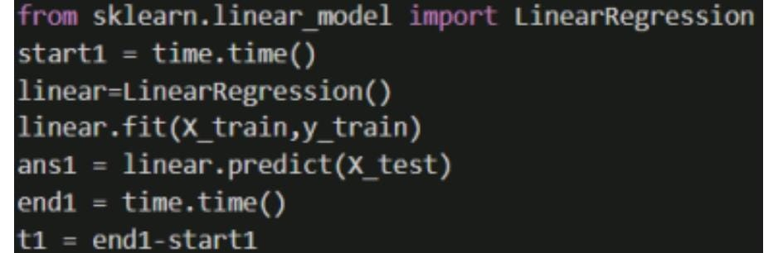
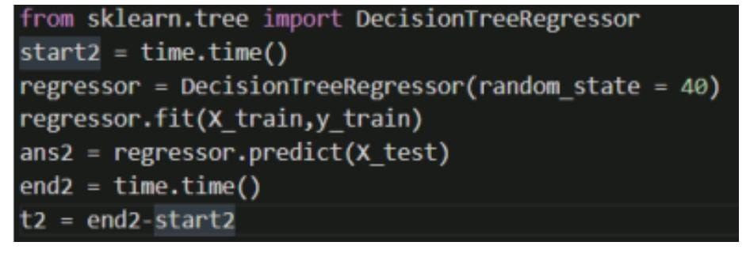
• Model Building.
1.Linear regression:
2.Decision Tree:

Slide 12
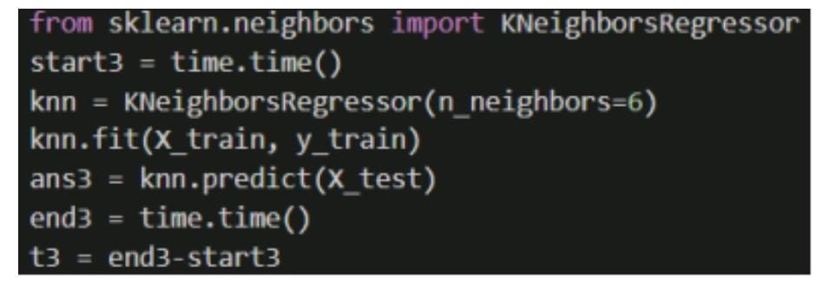
3.K-Nearest-Neighbour:
RESULTS:
1.Linear Regression Model
➢ Accuracy of Linear Regression model is: 0.63134131503029
➢ Mean Absolute Error: 0.05878246463205686
➢ Mean Squared Error: 0.00625827169726636
➢ Root Mean Squared Error: 0.07910923901331854

Slide 13
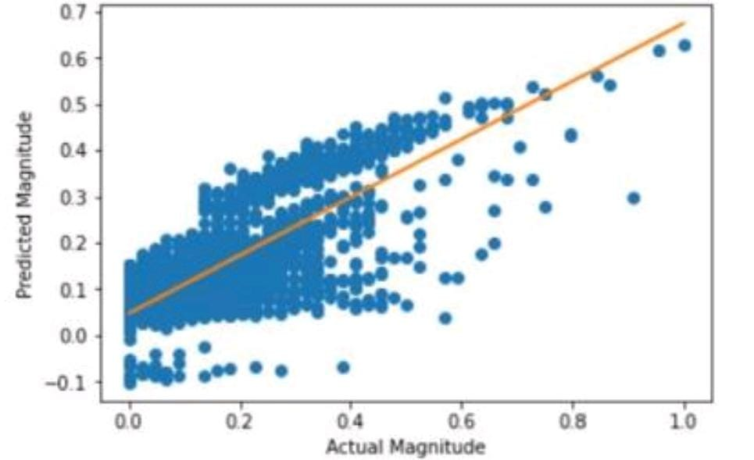
2.Decision Tree Model
➢ Accuracy of Decision Tree model is: 0.9932960893884235.
➢ Mean Absolute Error: 0.0006909999621372331
➢ Mean Squared Error: 0.00011380416561969702
➢ Root Mean Squared Error: 0.010667903525046383

Slide 14
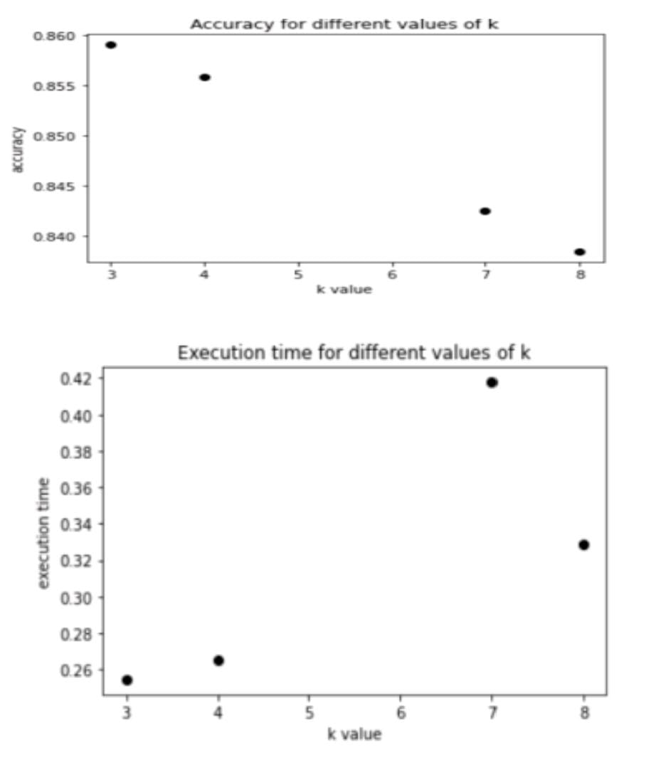
3. KNN Model
➢ Accuracy of KNN model is: 0.8457466919393031
➢ Mean Absolute Error: 0.03305598677318794
➢ Mean Squared Error: 0.002618571462992348
➢ Root Mean Squared Error: 0.051171979275696854

Slide 15
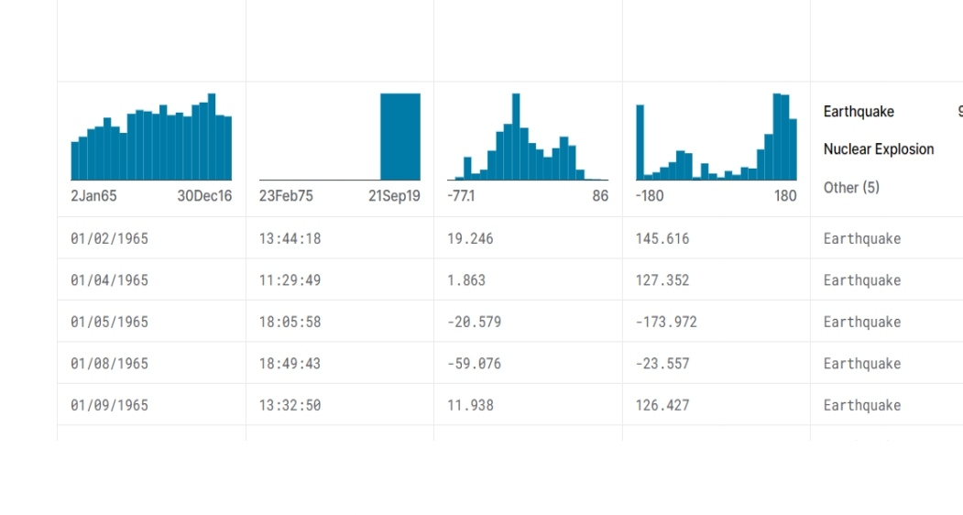
INNOVATION:
Given data set:

Slide 16
HYPER PARAMETER TUNING:
1) OPTIMIZING LINEAR REGRESSION:
The linear regression model might be the simplest predictive model that learns from data .The model has one coefficient for each input and the predicted output is simply the weights of some inputs and coefficients. In this section, we will optimize the coefficients of a linear regression mode First, let’s define a synthetic regression problem that we can use as the focus of optimizing the model. First, we need to split the dataset into train and test sets. It is important to hold back some data not used in optimizing the model so that we can prepare a reasonable estimate of the performance of the model when used to make predictions on new data.
# optimize linear regression coefficients for regression dataset
from numpy.random import randn
from numpy.random import rand
from sklearn.datasets import make_regression
from sklearn.model_selection import train_test_split
from sklearn.metrics import mean_squared_error

Slide 17
# linear regression
def predict_row(row, coefficients):
# add the bias, the last coefficient
result = coefficients[-1]
# add the weighted input
for i in range(len(row)):
result += coefficients[i] * row[i]
return result
# use model coefficients to generate predictions for a dataset of rows
def predict_dataset(X, coefficients):
yhats = list()
for row in X:
# make a prediction
yhat = predict_row(row, coefficients)
# store the prediction
yhats.append(yhat)
return yhats

Slide 18
# objective function
def objective(X, y, coefficients):
# generate predictions for dataset
yhat = predict_dataset(X, coefficients)
# calculate accuracy
score = mean_squared_error(y, yhat)
return score
# hill climbing local search algorithm
def hillclimbing(X, y, objective, solution, n_iter, step_size):
# evaluate the initial point
solution_eval = objective(X, y, solution)
# run the hill climb
for i in range(n_iter):
# take a step
candidate = solution + randn(len(solution)) * step_size
# evaluate candidate point
candidte_eval = objective(X, y, candidate

Slide 19
# check if we should keep the new point
if candidte_eval <= solution_eval:
# store the new point
solution, solution_eval = candidate, candidte_eval
# report progress
print('>%d %.5f' % (i, solution_eval))
return [solution, solution_eval]
# define dataset
X, y = make_regression(n_samples=1000, n_features=10,
n_informative=2, noise=0.2, random_state=1)
# split into train test sets
X_train, X_test, y_train, y_test = train_test_split(X, y, test_size=0.33)
# define the total iterations
n_iter = 2000
# define the maximum step size
step_size = 0.15

Slide 20
# determine the number of coefficients
n_coef = X.shape[1] + 1
# define the initial solution
solution = rand(n_coef)
# perform the hill climbing search
coefficients, score = hillclimbing(X_train, y_train, objective, solution, n_iter, step_size)
print('Done!’)
print('Coefficients: %s' % coefficients)
print('Train MSE: %f' % (score))
# generate predictions for the test dataset
yhat = predict_dataset(X_test, coefficients)
# calculate accuracy
score = mean_squared_error(y_test, yhat)
print('Test MSE: %f' % (score))

Slide 21
2)DECISION TREE:
AVOIDING OVERFITTING:
The techniques for preventing overfitting remain largely the same as for decision tree classifiers. However, it seems that not many people actually take the time to prune a decision tree for regression, but rather they elect to use a random forest regressor (a collection of decision trees) which are less prone to overfitting and perform better than a single optimized tree. The common argument for using a decision tree over a random forest is that decision trees are easier to interpret, you simply look at the decision tree logic. However, in a random forest, you're not going to want to study the decision tree logic of 500 different trees. Luckily for us, there are still ways to maintain interpretability within a random forest without studying each tree manually.
IMPLEMENTATION:
from sklearn.tree import DecisionTreeRegressor
start2 = time.time()
regressor = DecisionTreeRegressor(random_state = 40)
regressor.fit(X_train,y_train)
ans2 = regressor.predict(X_test)
end2 = time.time()
t2 = end2-start2

Slide 22
3)KNN MODEL:
A k-nearest neighbors is algorithm used for classification and regression. It classifies a new data point by finding the k-nearest points in the training dataset and assigns it the majority class among those neighbors.
Machine learning algorithms have hyperparameters that allow you to tailor the behavior of the algorithm to your specific dataset. Hyperparameters Tuning can improve model performance by about 20% to a range of 77% for all evaluation matrices. Hyperparameter tuning in k-nearest neighbors (KNN) is important because it allows us to optimize the performance of the model. The KNN algorithm has several hyperparameters that can significantly affect the accuracy of the model, such as the number of nearest neighbors to consider (k), the distance metric used to measure similarity, and the weighting scheme used to aggregate the labels of the nearest neighbors.
Required Libraries:
• NumPy
• Pandas
• Scikit-learn
• Matplotlib

Slide 23
Things to keep in mind when performing turning:
1. Understand the parameters: The main hyperparameter to tune in knearest neighbors is k, the number of neighbors to consider. Other parameters include distance metrics, weights, and algorithm types.
2. Select a distance metric: Choose the right distance metric to measure the similarity between the data points. Common distance metrics include Euclidean, Manhattan, and cosine distance.
3. Select an appropriate value for k: Selecting a value for k is crucial in knearest neighbors. A larger value of k provides a smoother decision boundary but may not be suitable for all datasets. A smaller value of k may lead to overfitting.
4. Choose an algorithm type: k-nearest neighbors has two algorithm types: brute-force and tree-based. Brute-force algorithm computes the distances between all pairs of points in the dataset while tree-based algorithm divides the dataset into smaller parts.
5. Cross-validation: Cross-validation is a technique used to validate the performance of the model. It involves splitting the dataset into training and testing sets and evaluating the model's performance on the testing set
6. Grid search: Grid search is a hyperparameter tuning technique that involves testing a range of values for each hyperparameter to find the best combination of values.
7. Random search: Random search is another hyperparameter tuning technique that randomly selects a combination of hyperparameter values to test.

Slide 24
8. Bias-variance tradeoff: k-nearest neighbors is prone to overfitting due to the high variance in the model. Regularization techniques such as L1 and L2 regularization can be used to mitigate overfitting.
9. Data preprocessing: Data preprocessing plays a crucial role in k-nearest neighbors. Scaling the data using techniques such as normalization and standardization can improve the model's performance. Outlier removal and feature selection can also help improve the model's performance.
IMPLEMENTATION:
from sklearn.neighbors import KNeighborsRegressor
start3 = time.time()
knn = KNeighborsRegressor(n_neighbors=6)
knn.fit(X_train, y_train)
ans3 = knn.predict(X_test)
end3 = time.time()
t3 = end3-start3

Slide 25
DEVELOPMENT PART 1:
Data Preprocessing:
INPUT:
df = df.drop('id',axis=1)
import datetime
import time
timestamp = []
for d, t in zip(df['date'], df['time’]):
ts = datetime.datetime.strptime(d+' '+t, '%Y.%m.%d %I:%M:%S %p') timestamp.append(time.mktime(ts.timetuple()))
timeStamp = pd.Series(timestamp)
df['Timestamp'] = timeStamp.values
final_data = df.drop(['date', 'time'], axis=1)
final_data = final_data[final_data.Timestamp != 'ValueError’]
df = final_data df.head()

Slide 26
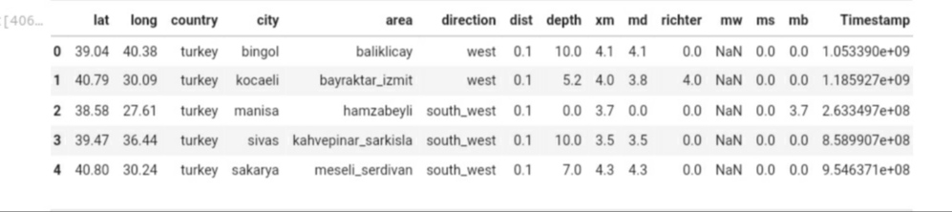
OUTPUT:

Slide 27
df.dtype:
lat float64
long float64
country object
city object
area object
direction object
dist float64
depth float64
xm float64
md float64
richter float64
mw float64
ms float64
mb float64
Timestamp float64
dtype: object

Slide 28
# Data Encoding
label_encoder = preprocessing.LabelEncoder()
for col in df.columns:
if df[col].dtype == 'object':
label_encoder.fit(df[col])
df[col] = label_encoder.transform(df[col])
df.dtypes
OUTPUT:
Lat float64
long float64
Country int64
city int64
area int64
direction int64
dist float64

Slide 29
deftype:object
df,isnull().sum()
OUTPUT:
Lat 0
long 0
Country 0
City 0
Area 0
Direction 0
Dist 13945
Depth 0
depth float64
Xm float64
Md float64
richter float64
Mw float64
Ms float64
mb float64
timestamp float64

Slide 30
Xm 0
md 0
Richter 0
mw 19004
Ms 0
mb 0
Timestamp 0
dtype: int64
# Imputing Missing Values with Mean
si=SimpleImputer(missing_values = np.nan, strategy="mean")
si.fit(df[["dist","mw"]])
df[["dist","mw"]] = si.transform(df[["dist","mw"]])
df.isnull().sum()
Lat 0
long 0
country 0
City 0

Slide 31
area 0
Direction 0
dist 0
Depth 0
Xm 0
md 0
richter 0
mw 0
Ms 0
mb 0
Timestamp 0
dtype: int64
Data Visualization
import plotly.express as px
px.scatter(df, x='richter',y='xm', color="direction")

Slide 32
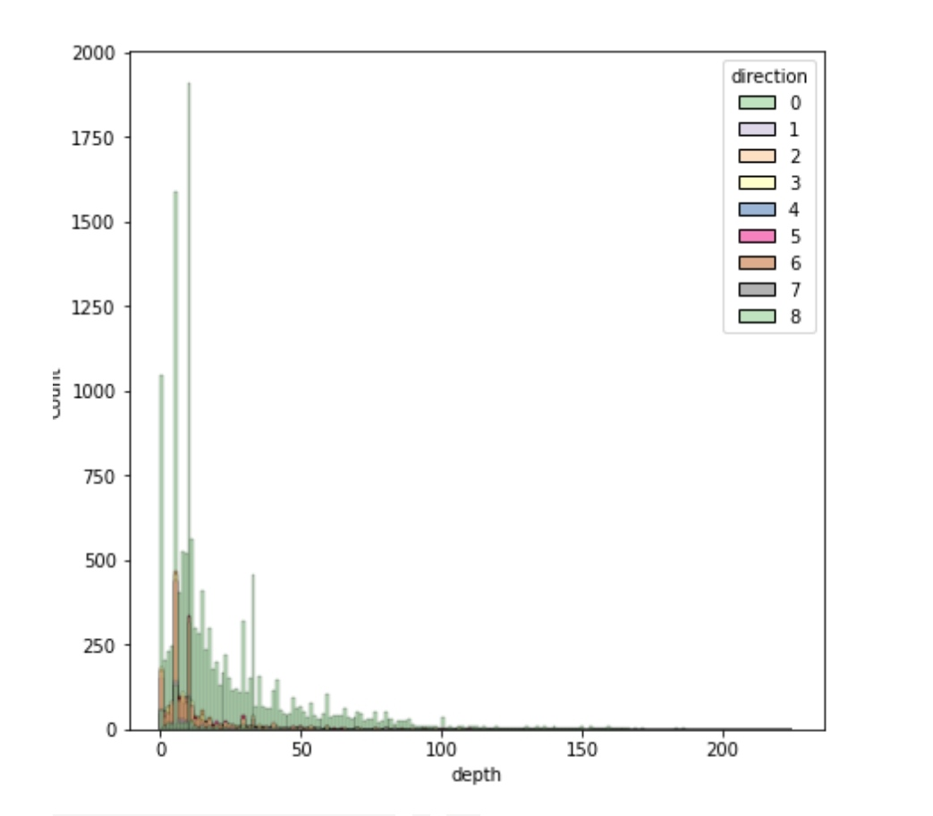
plt.figure(figsize=(7,7))
sns.histplot(data=df, x='depth', hue='direction',palette = 'Accent')
plt.show()

Slide 33
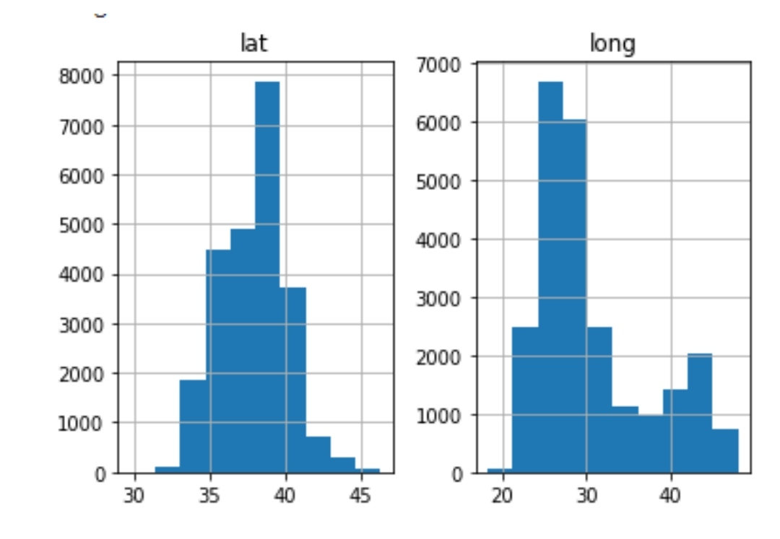
plt.figure(figsize=(7,7))
df[['lat','long']].hist()
plt.show()

Slide 34
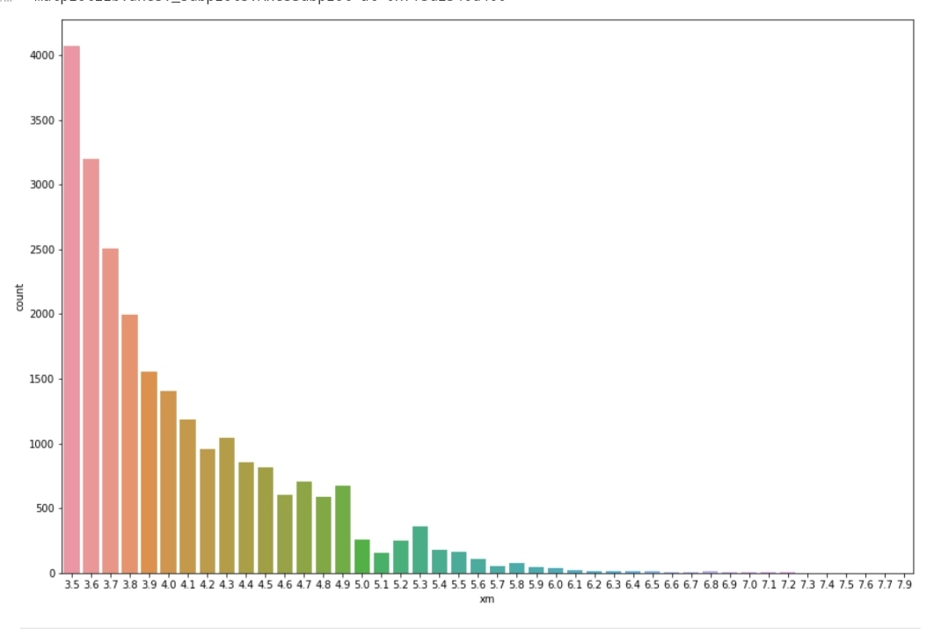
plt.figure(figsize=(15,10))
sns.countplot(df.xm)
OUTPUT:

Slide 35
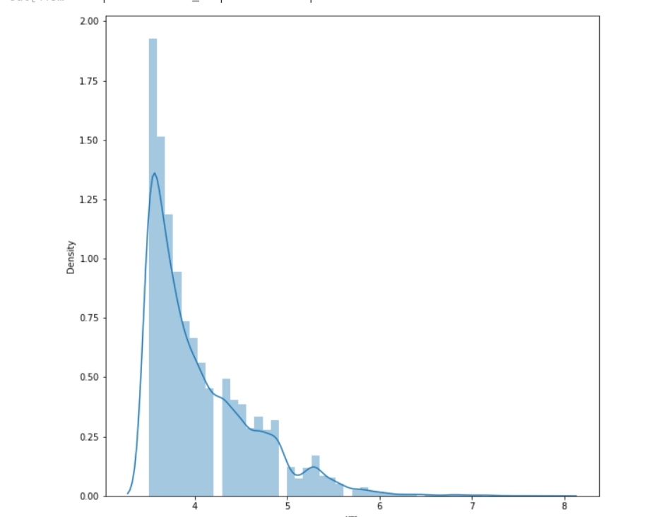
plt.figure(figsize=(10,10))
sns.distplot(df.xm)
OUTPUT:

Slide 36
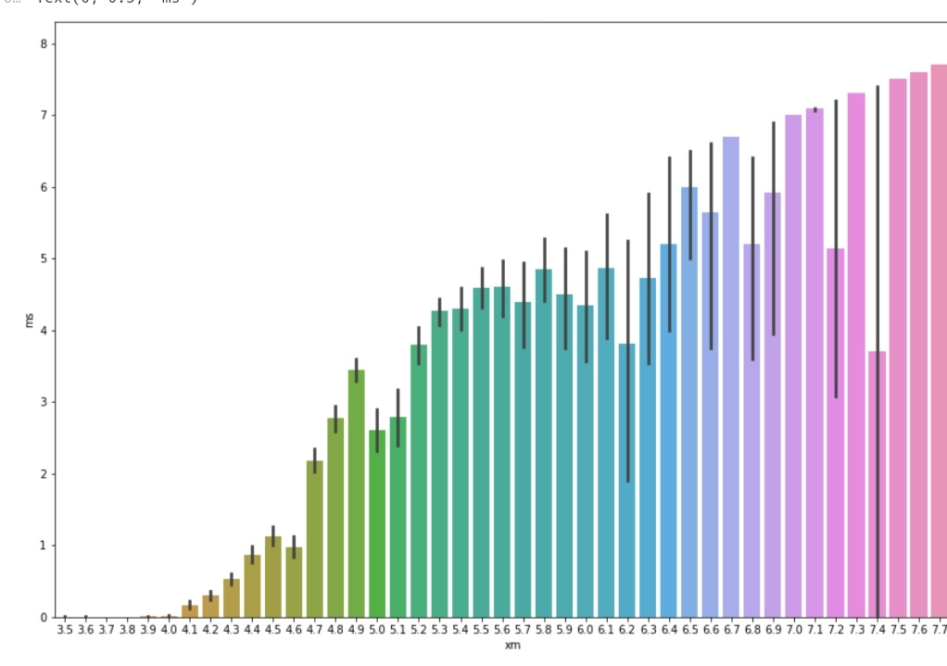
plt.figure(figsize=(15,10))
sns.barplot(x=df['xm'], y=df['ms'])
plt.xlabel('xm')
plt.ylabel('ms')
OUTPUT:
Text(0, 0.5, 'ms')

Slide 37
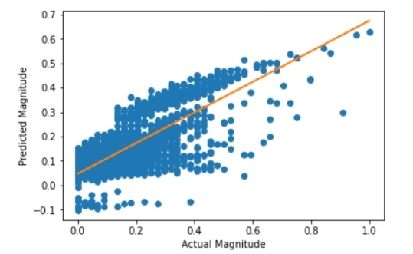
plt.scatter(df.depth, df.xm)
plt.xlabel("Depth")
plt.ylabel("xm")
plt.show()
Correlation between Attributes
most_correlated = df.corr()['xm'].sort_values(ascending=False)
most_correlated

Slide 38
OUTPUT:
xm 1.000000
Ms 0.699579
mb 0.628382
richter 0.426653
mw 0.420695
Depth 0.302926
Md 0.241432
area 0.125275
city 0.107436
direction 0.087696
long 0.071856
Dist 0.002853
lat -0.010347
country -0.056115
Timestamp -0.542092
Name: xm, dtype: float64

Slide 39
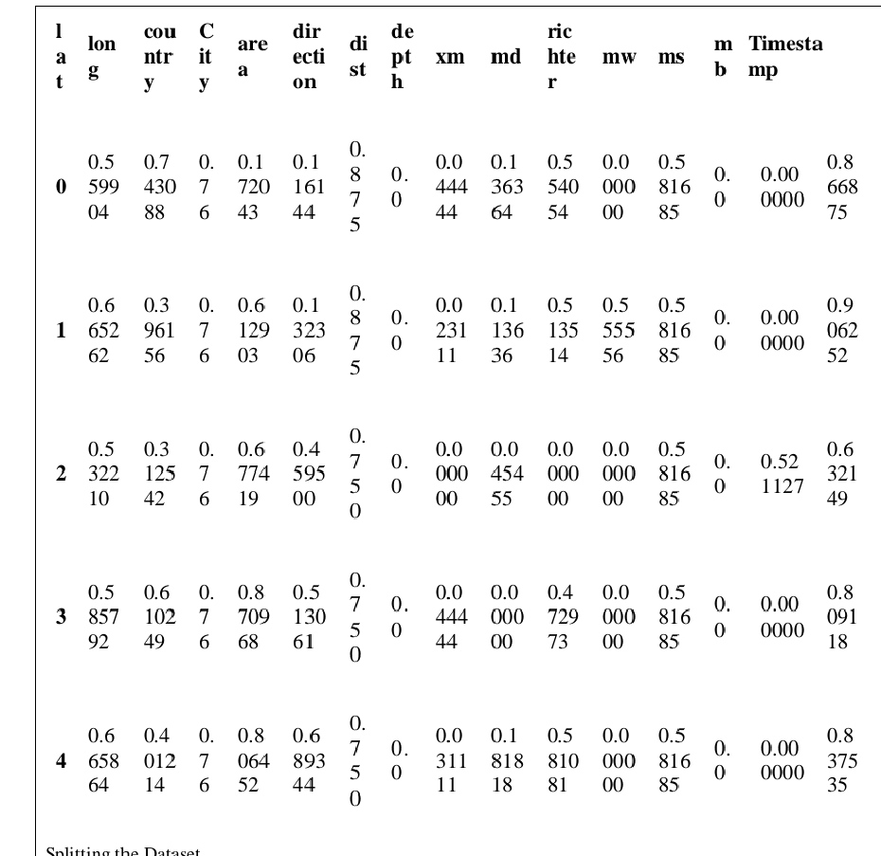
Normalization of data:
# Using MinMaxScaler
scaler = preprocessing.MinMaxScaler()
d = scaler.fit_transform(df)
df = pd.DataFrame(d, columns=df.columns)
df.head()

Slide 40
Creating Models
Linear Regression
from sklearn.linear_model import LinearRegression
start1 = time.time()
linear=LinearRegression()
linear.fit(X_train,y_train)
ans1 = linear.predict(X_test)
end1 = time.time()
t1 = end1-start1
accuracy1=linear.score(X_test,y_test)
print("Accuracy of Linear Regression model is:",accuracy1)
Accuracy of Linear Regression model is: 0.63134131503029

Slide 41
from sklearn import metrics
print("Linear Regression")
print('Mean Absolute Error:‘,
metrics.mean_absolute_error(y_test, ans1))
print('Mean Squared Error:', metrics.mean_squared_error(y_test, ans1))
print('Root Mean Squared Error:',
np.sqrt(metrics.mean_squared_error(y_test, ans1)))
Linear Regression :
Mean Absolute Error: 0.05878246463205686
Mean Squared Error: 0.00625827169726636
Root Mean Squared Error: 0.07910923901331854
plt.plot(y_test, ans1, 'o')
m, b = np.polyfit(y_test,ans1, 1)
plt.plot(y_test, m*y_test + b)
plt.xlabel("Actual Magnitude")
plt.ylabel("Predicted Magnitude")

Slide 42
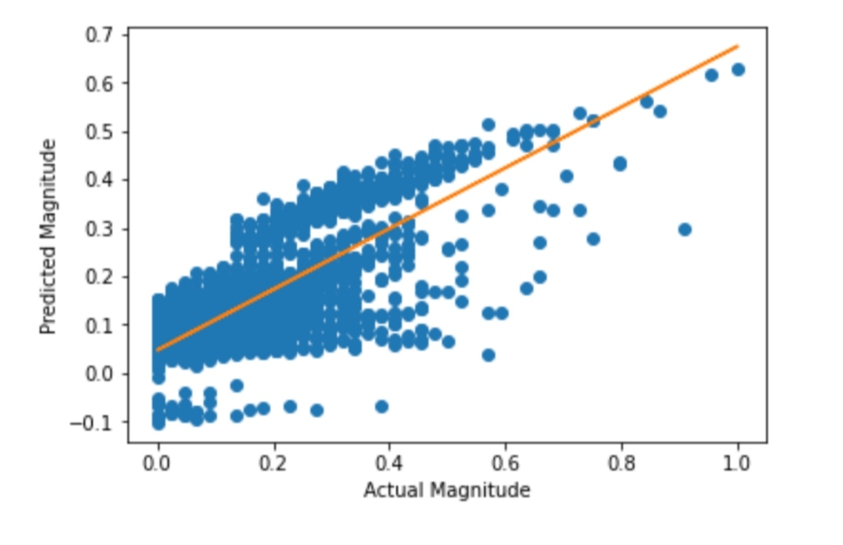
OUTPUT:
Text(0, 0.5, 'Predicted Magnitude')

Slide 43
2. Decision Tree
from sklearn.tree import DecisionTreeRegressor
start2 = time.time()
regressor = DecisionTreeRegressor(random_state = 40)
regressor.fit(X_train,y_train)
ans2 = regressor.predict(X_test)
end2 = time.time()
t2 = end2-start2
accuracy2=regressor.score(X_test,y_test)
print("Accuracy of Decision Tree model is:",accuracy2)
Accuracy of Decision Tree model is: 0.9932960893884235
print("Decision Tree")
print('Mean Absolute Error:',
metrics.mean_absolute_error(y_test, ans2))
print('Mean Squared Error:', metrics.mean_squared_error(y_test, ans2))
print('Root Mean Squared Error:',
np.sqrt(metrics.mean_squared_error(y_test, ans2)))

Slide 44
Decision Tree
Mean Absolute Error: 0.0006909999621372331
Mean Squared Error: 0.00011380416561969702
Root Mean Squared Error: 0.010667903525046383
3.KNN Model
from sklearn.neighbors import KNeighborsRegressor
start3 = time.time()
knn = KNeighborsRegressor(n_neighbors=6)
knn.fit(X_train, y_train)
ans3 = knn.predict(X_test)
end3 = time.time()
t3 = end3-start3
accuracy3=knn.score(X_test,y_test)
print("Accuracy of KNN model is:",accuracy3)
Accuracy of KNN model is: 0.8457466919393031
print("KNN Model")
print('Mean Absolute Error:', metrics.mean_absolute_error(y_test, ans3))
print('Mean Squared Error:', metrics.mean_squared_error(y_test, ans3))

Slide 45
print('Root Mean Squared Error:', np.sqrt(metrics.mean_squared_error(y_test, ans3))) KNN Model :
Mean Absolute Error: 0.03305598677318794
Mean Squared Error: 0.002618571462992348
Root Mean Squared Error: 0.051171979275696854
import random
info = {}
for i in range(10):
k = random.randint(2,10)
startk = time.time()
knn = KNeighborsRegressor(n_neighbors=k)
knn.fit(X_train, y_train)
ans3 = knn.predict(X_test)
endk = time.time()
tk = endk-startk
acc3=knn.score(X_test,y_test)
info[k] = [acc3,tk]
for i in info:
print("for k =",i,": accuracy =",info[i][0])

Slide 46
for k = 4 : accuracy = 0.8559118607470738
for k = 9 : accuracy = 0.8334625255508568
for k = 8 : accuracy = 0.8384577534478264
for k = 6 : accuracy = 0.8457466919393031
for k = 5 : accuracy = 0.8519381145638621
for k = 10 : accuracy = 0.8296048410841246
for k = 7 : accuracy = 0.8425261199362686
x = list(info.keys())
yacc = []
for i in info:
yacc.append(info[i][0])
plt.plot(x, yacc, 'o', color='black');
plt.xlabel("k value")
plt.ylabel("accuracy");
plt.title("Accuracy for different values of k")

Slide 47
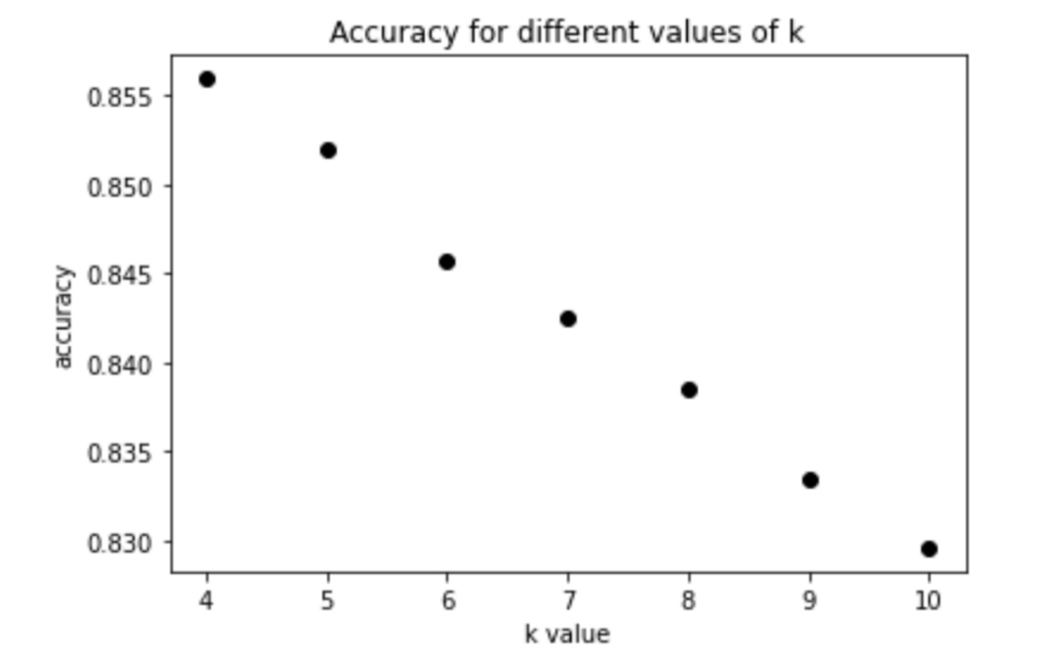
OUTPUT:
Text(0.5, 1.0, 'Accuracy for different values of k')
yt = []
for i in
info: yt.append(info[i][1])
plt.plot(x, yt, 'o', color='black');

Slide 48
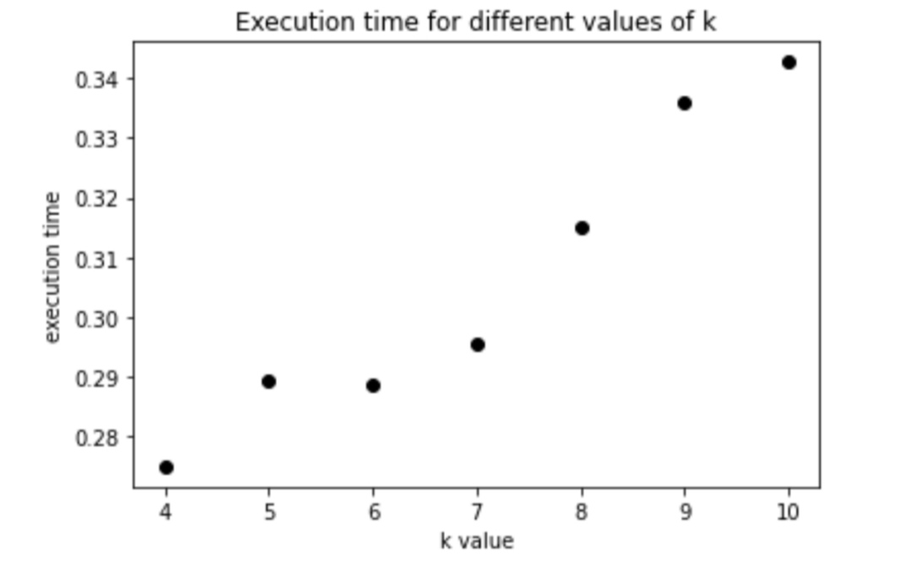
plt.xlabel("k value")
plt.ylabel("execution time");
plt.title("Execution time for different values of k")
OUTPUT:
Text(0.5, 1.0, 'Execution time for different values of k')

Slide 49
II. PROBLEM DEFINITION:
Earthquake prediction using machine learning (ML) is a task of developing a model that can accurately predict the magnitude of an earthquake, given parameters such as longitude, latitude, depth, duration magnitude, country etc. We use various prediction models to determine this.
III. DATASETS:
When a specific field is researched in terms of machine learning, the first question is where to find data. As for earthquake datasets, various organizations and research institutions are constantly monitoring seismic activity of all over the world. The structure of earthquake datasets are usually presented in the form of a table, each record of which corresponds to a certain seismic event. The sets of attributes are different for data published in different datasets. In this project we make use of two datasets.

Slide 50
DATASET 1:
earthquake1.csv Contains all the recorded earthquakes in Turkey between 1910-2017 larger than 3.5 intensity. The parameters are:
• Id: order number of the earthquake
• Date: earthquake occurrence date
• Time: time of the earthquake
• Lat: latitude of the earthquake epicenter
• Long: longitude of the earthquake epicenter
• Country: country of the earthquake epicenter
• City: province of the occurred earthquake
• Area: region of the occurred earthquake
• Direction: direction of the earthquake signa
l • Dist: distance of direction in km
• Depth: depth of the occurred earthquake (distance from the surface)
• Xm: the largest of the given magnitude values
• Md: magnitude depending on time
• Richter: Richter magnitude or the local magnitude (ML)
• Mw: moment magnitude
• Ms: surface wave magnitude
• Mb: body wave magnitude

Slide 51
DATASET 2:
earthquake2.csv Contains all Significant Earthquakes that occurred in the period of 1965-2016.The parameters are:
• Time: Time of the earthquake
• Latitude: latitude of the earthquake epicenter
• Longitude: longitude of the earthquake epicenter
• Depth: depth of the occurred earthquake (distance from the surface)
• mag: size of the earthquake
• magType: type of magnitude occurred (ml or ms)
• Nst: Number of seismic stations
• Gap: Region along an active fault where stress is accumulating because no
• earthquakes have occurred there recently
• D-min: Horizontal distance from the epicenter to the nearest station
• RMS: In general, the smaller this number, the more reliable is the calculated depth of the earthquake
• Id: order number of the earthquake
• Updated: updation in sequence of earthquake
• Place: place where earthquake occurred
• Type: type of earthquake occurred
• Horizontal error: error in range

Slide 52
• Updated: updation in sequence of earthquake
• Place: place where earthquake occurred
• Type: type of earthquake occurred
• Horizontal error: error in range
• Depth error: error occurred in calculation of depth of earthquake
• magError: error occurred in calculation of magnitude of earthquake
• magNst: error occurred in calculation of number of seismic stations
• Status: current status of earthquake
• Location source: source of location where earthquake occurred
• magSource: source where magnitude is occurred

Slide 53
IV. METHODS :
To begin with, the dataset is pre-processed to make it suitable for modelling. Second, the dataset is partitioned into training and testing data-set and third, different models are
constructed and fitted to the training data-set. The accuracy of the system is obtained by testing the system using the testing data. In this study, we explore, evaluate and analyze dataset
characteristics using different machine learning algorithms like linear regression, decision tree and KNN.
A. Linear Regression:
Linear Regression is a supervised Machine Learning model which assumes a linear relationship between the input variables (x) and the single output variable (y). For linear regression, we will use only numerical data (float). This form of analysis estimates the coefficients of the linear equation, involving one or more independent variables that best predict the value of the dependent variable. For Earthquake prediction, we use various input variables (X) such as earthquake occurrence date, surface wave magnitude, body wave magnitude, Richter magnitude or the local magnitude (ML) for the first dataset to predict the output variable (Y) - Xm, the largest of the given magnitude values. For the 2nd dataset, we predict the value of magnitude (Y) using variables such as the number of seismic stations, type of magnitude that occurred (ml or ms), gap etc.
B. Decision Tree:
Decision-tree algorithm falls under the category of supervised learning algorithms. It works for both continuous as well as categorical output variables. Decision tree regression observes the features of an object and trains a model in the structure of a tree to predict data in the future to produce meaningful continuous output. The goal of a decision tree is to learn a model that predicts the value of the magnitude of the earthquake by learning simple decision rules inferred from the data features of the given dataset. For example, if the Richter value > 0.49, then XM value will be approx. 0.07. For our decision tree, the first node is the column with the highest information gain i.e., X[9] which is md - magnitude depending on time.

Slide 54
C. K-Nearest Neighbor:
K nearest neighbours is a simple algorithm that uses ‘feature similarity’ to predict the values of any new data points. This means that the new point is assigned a value based on how closely it resembles the points in the training set. the KNN algorithm would find the k-nearest data points to a new data point and predict the continuous output based on the average of the output values of the nearest neighbours. For earthquake prediction, we use k-Nearest Neighbours Regressor. Even though we had multiple features, the importance of each feature in the Euclidean distance calculation can vary. To handle this, we performed normalization before calculating the distance, so that all features are on the same scale and have an equal contribution to the distance
V. EVALUATION AND DISCUSSIONS DATA PRE-PROCESSING :
For both the datasets the following pre-processing steps were taken:
• First, we dropped the ‘id’ column since it is not useful for prediction.

Slide 55
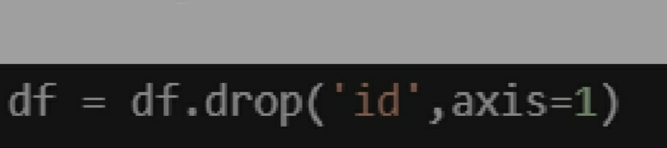
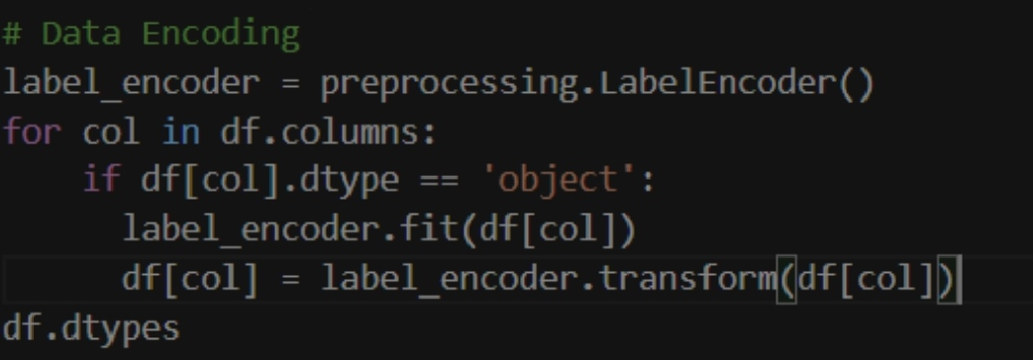
V. EVALUATION AND DISCUSSIONS DATA PRE-PROCESSING :
For both the datasets the following pre-processing steps were taken:
• First, we dropped the ‘id’ column since it is not useful for prediction.
• Next we converted categorical variables into numerical values so that it could be easily fitted to a machine learning model using a label encoder.

Slide 56
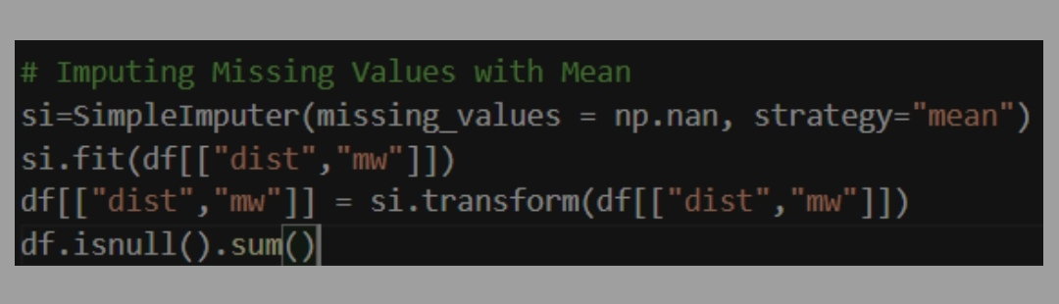
• Imputation with SimpleImputer which replaced the missing data with mean was done to handle null values
• Normalization of the data was done using MinMax Scaler. The Min-Max scaling method helps the dataset to shift and rescale the values of their attributes, so they end up ranging between 0 and 1.

Slide 57
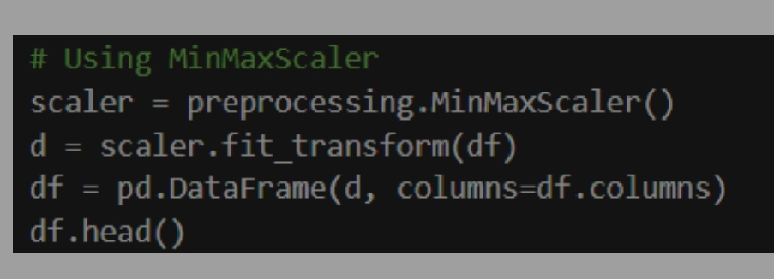
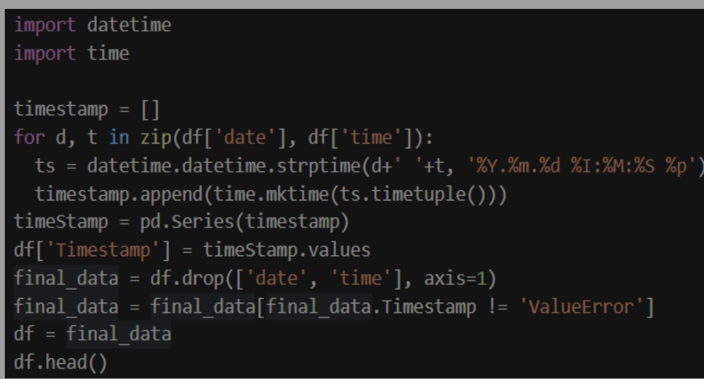
• Dataset1 had two columns ‘date’ and ‘time’. It was converted to another column ‘timestamp’ using packages such as ‘datetime’ and ‘time’.

Slide 58
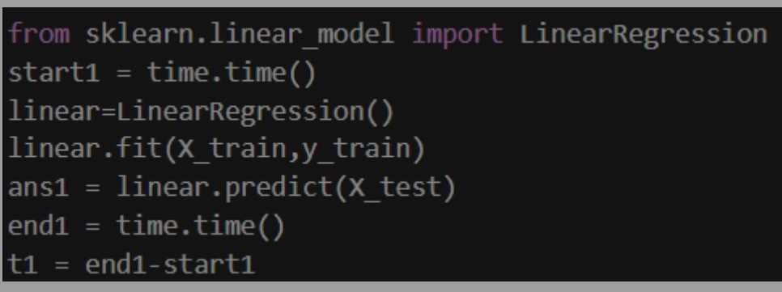
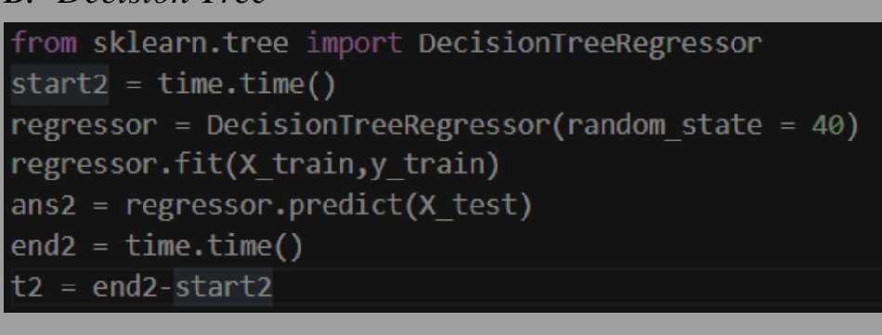
CREATING MODELS :
A. Linear Regression :
B. Decision Tree :

Slide 59
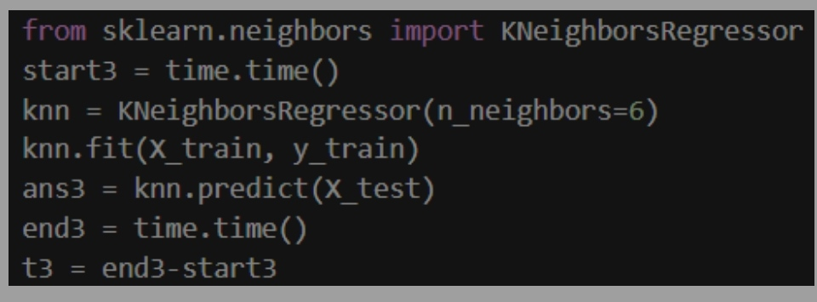
C. KNN:
RESULTS DATASET 1:
earthquake1.csv Linear Regression Model
• Accuracy of Linear Regression model is: 0.63134131503029
• Mean Absolute Error: 0.05878246463205686
• Mean Squared Error: 0.00625827169726636
• Root Mean Squared Error: 0.07910923901331854

Slide 60
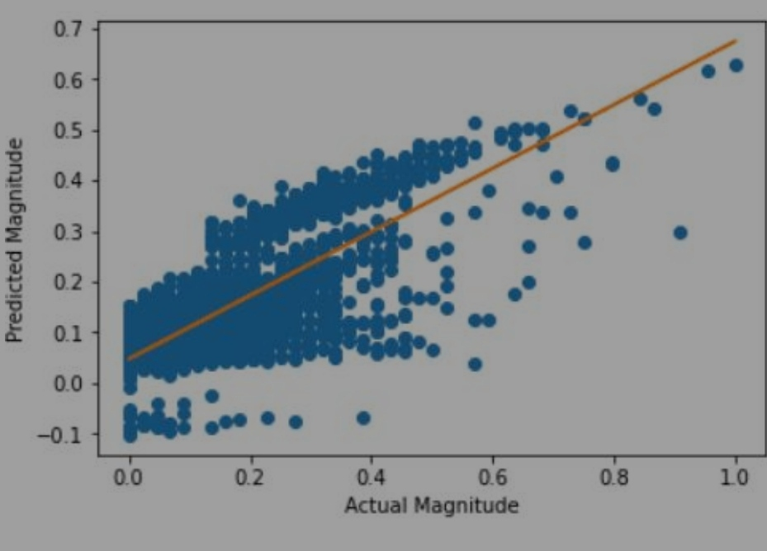
Decision Tree Model :
• Accuracy of Decision Tree model is: 0.9932960893884235.
• Mean Absolute Error: 0.0006909999621372331
• Mean Squared Error: 0.00011380416561969702
• Root Mean Squared Error: 0.010667903525046383

Slide 61
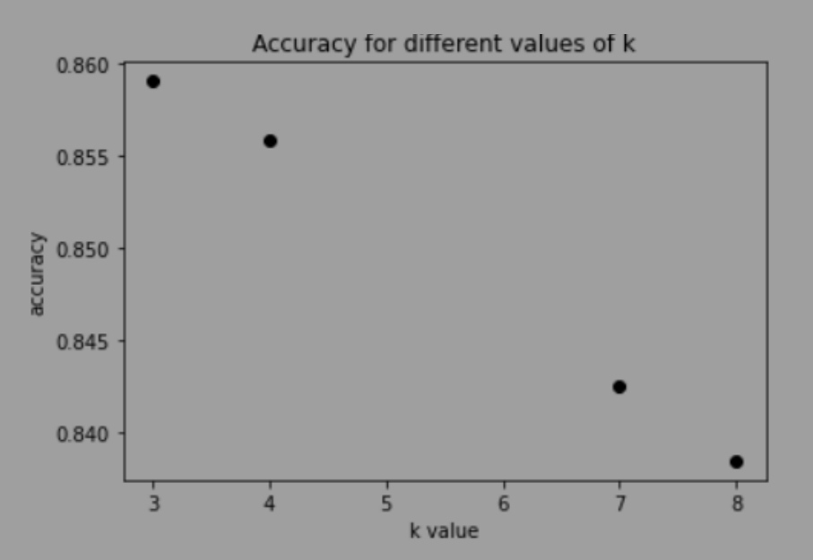
KNN Model:
• Accuracy of KNN model is: 0.8457466919393031
• Mean Absolute Error: 0.03305598677318794
• Mean Squared Error: 0.002618571462992348
• Root Mean Squared Error: 0.051171979275696854

Slide 62
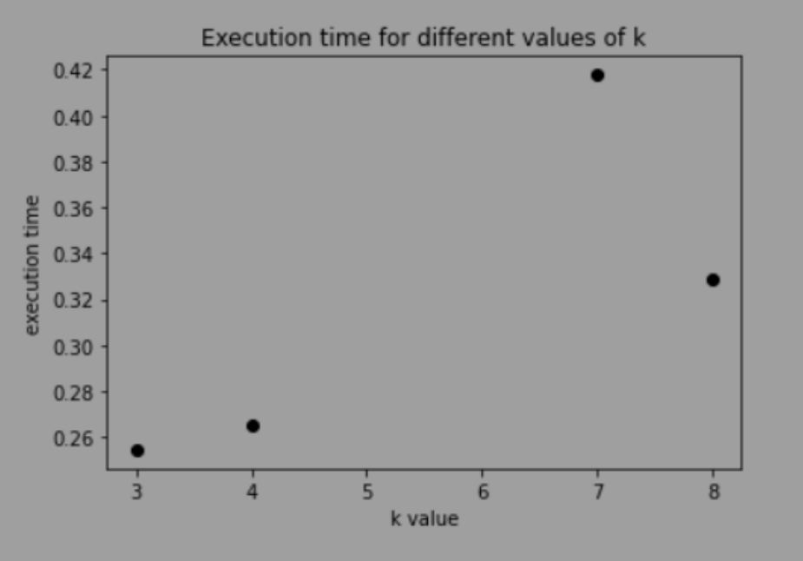
VI. FINDINGS AND FUTURE DIRECTIONS:
Comparing the performances of different ML models, we find that, For Dataset1, Minimum error is obtained in the Decision Tree with the maximum accuracy of 99.4 per cent, whereas, the error is maximum for linear regression which has the minimum accuracy amongst the 3 algorithms with 63.1 percent. For Dataset2, Minimum error is obtained in the linear regression model, however KNN has the maximum accuracy of 68.2 per cent. Error is maximum for decision tree which has lowest accuracy among the three models. In both the datasets, KNN model took the most time for executing whereas linear regression took the least amount of time. The field of earthquake prediction is an active area

Slide 63
of research and there have been significant advances in recent years. One of the most promising areas of research is the use of machine learning and artificial intelligence to analyze seismic data and identify patterns that may indicate an impending earthquake. Other areas of research include the use of satellite data, remote sensing, and geodetic measurements to detect precursory signs of an earthquake. While we do not yet have the capability to predict earthquakes with 100% accuracy, continued research and advancements in technology may bring us closer to this goalin the future.
CONCLUSION:
In conclusion, the development of an earthquake prediction model using Python represents a significant step towards mitigating the impact of seismic events. While earthquake prediction remains a complex and evolving field, this model showcases the potential of machine learning and data analysis in identifying patterns and trends that could aid in early warning systems and disaster preparedness. However, it's important to acknowledge that earthquake prediction is an ongoing challenge, and the model's accuracy and reliability should be continuously improved and validated through rigorous testing and research. As our understanding of seismic activity deepens and technology advances, such models have the potential to save lives and reduce the devastation caused by earthquakes.

